Slide 1
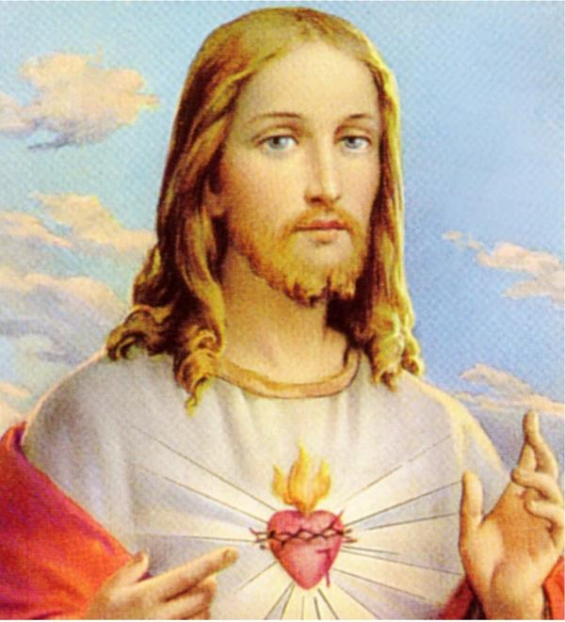
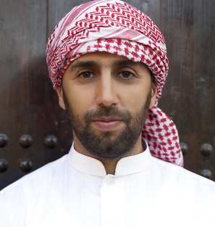
Foto 82226650 © Nataliya Kostenyukova | Dreamstime.com

